Slide 1
Chapter Two
How Stress Leads to Diving Emergencies

Slide 2
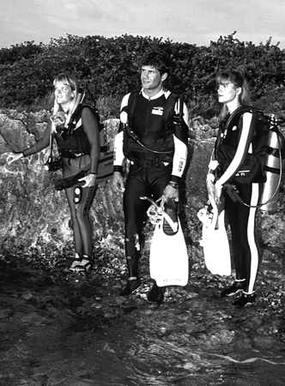
Topics In This Chapter
Stress in Diving
Pre-Dive Stress
Recognizing Pre-Dive Stress in Others
Recognizing Pre-Dive Stress in Yourself
Dealing with Pre-Dive Stress
Stress and Panic in the Water
Panicky Diver at the Surface
Panicky Diver Underwater
Effects of Stress on Breathing

Slide 3
Stress in Diving
Anxiety and apprehension may arise . . .
Before the dive
During the dive

Slide 4
Stress in Diving
Unrelieved stress
May continue to escalate
May be compounded by minor problems
May lead to panic

Slide 5
Pre-Dive Stress
Common sources of pre-dive stress
Diving in new or unfamiliar sites
Adverse conditions
New diving activities
Peer pressure
Diving with a new buddy
Using new or unfamiliar equipment

Slide 6

Recognizing Pre-Dive Stress in Others
Withdrawal
Staying away from the crowd, seeking a private place
Having no opinion, or an “I don’t care” attitude
Unusually quiet
Moodiness

Slide 7
Recognizing Pre-Dive Stress in Others
Gear problems
Finding excuses to delay or abort the dive
Fumbling with gear

Slide 8
Recognizing Pre-Dive Stress in Others
Hyperactivity or excessive talking
False enthusiasm, to mask apprehension
Meaningless activity, to divert thoughts
Talking about nothing in particular, or constantly repeating
Using “dark” humor

Slide 9
Recognizing Pre-Dive Stress in Yourself
Pre-dive concerns often may be more
psychological than real
Fear of the unknown
Fear of failure, especially in front of others

Slide 10
Recognizing Pre-Dive Stress in Yourself
Conduct an honest self-examination
Is this an “experience expanding” activity, or am I exceeding my training and experience?
Do I have the skills to perform this dive safely?
If things start going wrong underwater, am I briefed and prepared for the contingencies?
Am I capable of looking after myself and my buddy in an emergency?

Slide 11
Dealing with Pre-Dive Stress
Separate fact from fiction
Start with a good dive plan
Address all intentions and contingencies
Ensure that everyone understands what is about to take place

Slide 12

Dealing with Pre-Dive Stress
Conduct a good dive briefing
Cover the dive plan, as well as an organized response to emergencies

Slide 13
Dealing with Pre-Dive Stress
Conduct a good buddy check
Catch accidents before they happen
Familiarize each diver with the other’s gear
Review hand signals, dive plan, and out-of-air emergencies

Slide 14
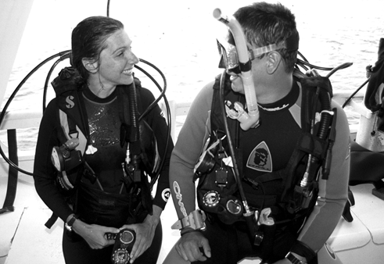
Dealing with Pre-Dive Stress
Talk about any apprehension
Discuss concerns with experienced divers and dive leaders
Define realistic dive-related expectations
Seek advice, to help overcome apprehension

Slide 15
Dealing with Pre-Dive Stress
Visualize the dive
Mentally create a possible progression of events
Superimpose the dive plan over the observed dive site
Carry a slate with the dive parameters on it
Anticipate problems, and mentally rehearse your response to each

Slide 16
Stress and Panic in the Water
Sources of stress during a dive
Poor visibility
Cold temperatures
Over exertion and/or breathing difficulty
Buddy separation
Leaking mask
Inability to keep buoyancy under control

Slide 17
Stress and Panic in the Water
Dealing with stress in the water
Act, don’t just react!
Stop where you are
Signal your buddy that you have a problem
Take 2 to 3 full breaths, to get your breathing under control
Calm down and find the problem
Look at your options and make a rational choice

Slide 18
Stress and Panic in the Water
Stress can quickly lead to panic
Minor issues can escalate, if not resolved
Panic may cause a diver to bolt for the surface

Slide 19
Panicky Diver at the Surface
Contributing factors
Frequently involves difficulty in staying comfortably afloat
Over-weighted
BC not inflated

Slide 20
Panicky Diver at the Surface
Contributing factors
Also may involve difficulty in breathing comfortably
Over-exerted
Choppy sea state
Poorly maintained regulator
Constricting wet suit, dry suit, or BC
Altered breathing pattern from general anxiety

Slide 21
Panicky Diver at the Surface
Classic signs of water-induced panic
Rapidly flailing arms
Body as high as possible above the water
Mask and regulator removed to ease breathing
Gasping for air
Eyes wide open in fright
Not rational

Slide 22
Panicky Diver at the Surface
Alternately, may exhibit passive panic
In passive panic, the diver is “frozen” and immobile
Passive panic may quickly and unexpectedly turn
to active panic

Slide 23
Panicky Diver at the Surface
Panicky diver may climb on top of any
other diver within reach
Stay out of reach until the situation is assessed
You want to be part of the solution, not part of the problem
You’ll be exposed to loss of regulator and mask, dropped weight belt, exhausting struggle
Approach needs to be reasoned and practiced

Slide 24
Panicky Diver Underwater
Most often stems from some type of
breathing difficulty
Over-exertion, caused by diver’s activity level or over-weighting
Poor regulator performance
Out-of-air emergency

Slide 25
Panicky Diver Underwater
Diver’s panic reaction
May be passive: frozen and immobile
May be active: bolting for the surface, or grabbing for other diver’s regulator (and possibly dislodging diver’s mask)
May quickly turn from passive to active
Exercise caution in approaching a breathing, immobile diver

Slide 26
Effects of Stress on Breathing
Breathing “trigger” is the build-up of
carbon dioxide (not a lack of oxygen)
CO₂ is a by-product of metabolism
Increased workload will increase levels of CO₂

Slide 27
Effects of Stress on Breathing
Anxiety causes an altered breathing pattern
Typically rapid and shallow breathing, or panting
Inefficient gas exchange
Quickly leads to exhaustion, due to hypoxia
Also creates a sense of suffocation, due to elevated CO₂ level

Slide 28
Effects of Stress on Breathing
Distress often can be relieved with normal
breathing
First you may need to deal with other issues, such as buoyancy at the surface
Then encourage the diver to take 2 to 3 full breaths
Encourage the diver to calm down
And then you may have a merely tired diver

Slide 29
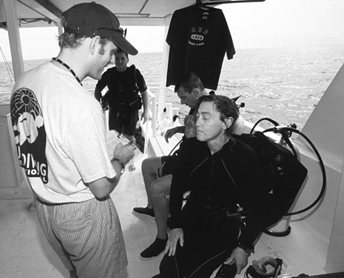
Summary
Panic is the greatest single cause of diving accidents
Unrelieved stress and accumulating problems produce panic
Be alert to the signs of stress and panic
Deal with apprehension and anxiety before they become worse

Slide 30
Scuba I.Q. Review

Slide 31
Scuba IQ Review
1
Q
What are some common sources of pre-dive stress?
A
Diving in new and unfamiliar sites
Adverse conditions
New diving activities (such as first night dive)
Peer pressure
Diving with a new buddy
Using new or unfamiliar equipment

Slide 32
Scuba IQ Review
2
Q
How might you recognize stress in your dive buddy?
A
Withdrawal
Hyperactivity
Constant talking
Gear fumbling
Inappropriate or dark humor
Moodiness

Slide 33
Scuba IQ Review
3
Q
Describe some ways you might help reduce pre-dive stress in yourself and a buddy.
A
Separate fact from fiction
Conduct a good dive briefing
Conduct a good buddy check
Talk to the dive leaders
Visualize the dive

Slide 34
Scuba IQ Review
4
Q
How can visualization be helpful to a scuba diver?
A
Can be used to forecast possible events, to prepare for the unexpected events of the dive. Having an idea of what might go wrong at critical moments will help you consider an appropriate response before the problem arises.

Slide 35
Scuba IQ Review
5
Q
What factors may cause stress and panic in a diver while underwater?
A
Poor visibility
Cold temperatures
An out of air emergency
Over exertion and/or breathing difficulty
Leaking mask
Buddy separation
Inability to keep buoyancy under control
The feeling of general discomfort in the water combined with a sense of inability to help themselves out of a crisis

Slide 36
Scuba IQ Review
6
Q
What dangers does the rescuer face when attempting to help a panicky diver?
A
The possibility of loss of the regulator and mask, dropped weight belt and an exhausting struggle

Slide 37
Scuba IQ Reveiw
7
Q
Why do alterations in breathing patterns affect a struggling or panicky diver?
A
It increases the feeling of suffocation and panic. This condition will rapidly result in exhaustion due to hypoxia (lowered blood level of oxygen) and the increasing sensation of air starvation due to the elevated level of the “trigger gas”, carbon dioxide.

Slide 38
Any Questions ?

